Slide 1
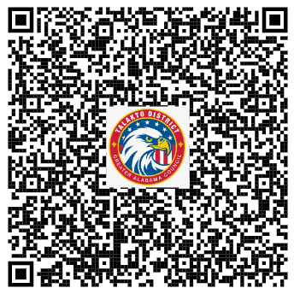
Talakto Communications:
Web Site: www.talakto.org
Click on Communications
Constant Contact Monthly Newsletters:
If you are not receiving monthly newsletters, use the QR Code to sign up for the Talakto and other Greater Alabama Council Email Newsletters. Please make sure your units know to sign up and are receiving them.

Slide 2
Talakto Communications:
What’s Next?
Cub Scout Day Camp Marketing Campaign
April Newsletter
Get your newsletter news in before the committee/commissioner meeting each month.

Slide 3
Follow us on Social Media for the latest Talakto updates, and tell your friends!
https://www.facebook.com/TalaktoGAC
https://www.instagram.com/talakto

Slide 4
Want something shared on Talakto’s Social Media? Send to Nate Mobley:
-(Nathaniel.mobley@gmail.com)
or
-Message Talakto on Facebook
https://www.facebook.com/TalaktoGAC
https://www.instagram.com/talakto

