Slide 1
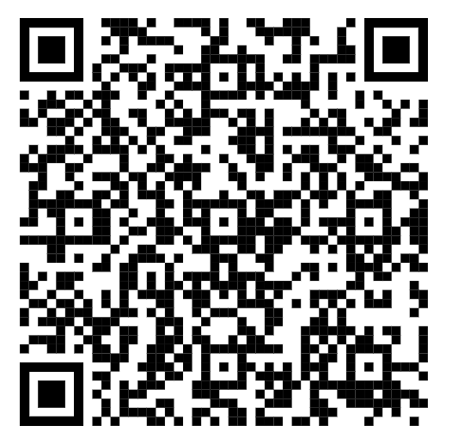
Welcome to the APRIL ROUNDTABLE!
All attendees please sign in. Be sure to make an entry for your unit’s attendance.
Jen’s hiding from the April Showers!
SIGN IN HERE

Slide 2
Welcome to the Talakto District Roundtable!
Don’t Forget…
Mother’s Day!
Memorial Day!

Slide 3
3 April 2025
Talakto District Roundtable
7:00 PM
Invocation – SBRS
Presentation of Colors – Kaskanampo Chapter OA
District Commissioner – Jimmy Sneddon
District Chairman – Jeremy Gaertner
District Director – Doug Malone
Training – Tom Billig – Training

Slide 4
3 April 2025
Talakto District
Scouts BSA Roundtable
7:15 PM
Scouts BSA Session Announcements
Recent Activities – SBRS
Recruiting – Richard Stone
Scoutmaster’s Minute – SBRS
Next: Roundtable 7 August 2025

Slide 5
hrsar2@att.net
Chris Whitacre

Slide 6
Welcome to the APRIL ROUNDTABLE!
All attendees please sign in. Be sure to make an entry for your unit’s attendance.
Jen’s hiding from the April Showers!
SIGN IN HERE

