Slide 1
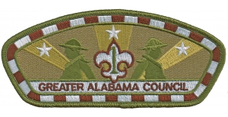



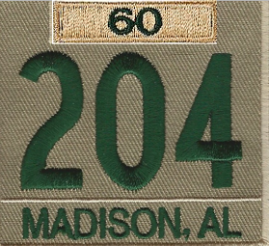
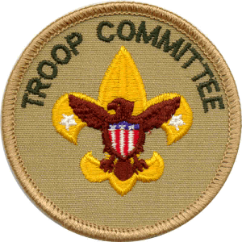
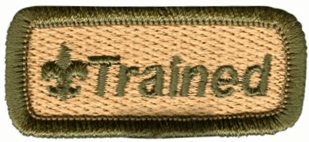

New Member Coordinator
Troop Committee
Every Scout Deserves a Trained Leader
*Youth Protection is Prerequisite!
Dr. Rich Goodwin
rgoodwin49@outlook.com
https://www.scouting.org/training/

Slide 2
Course Objectives
As a result of this course, participants will be able to:
  Explain what a New Member Coordinator is.
  Understand the New Member Coordinator’s relationship and responsibilities to the Troop families.
  Understand the New Member Coordinator’srelationship to the Troop Committee.
Formerly known as membership chair…

Slide 3
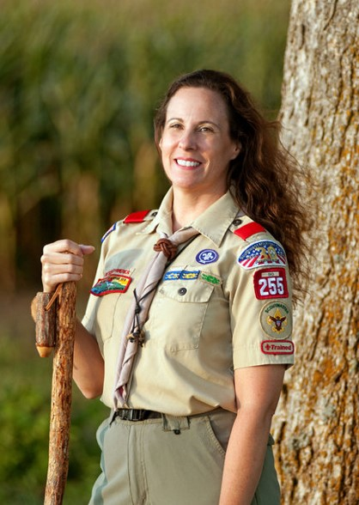
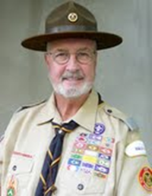
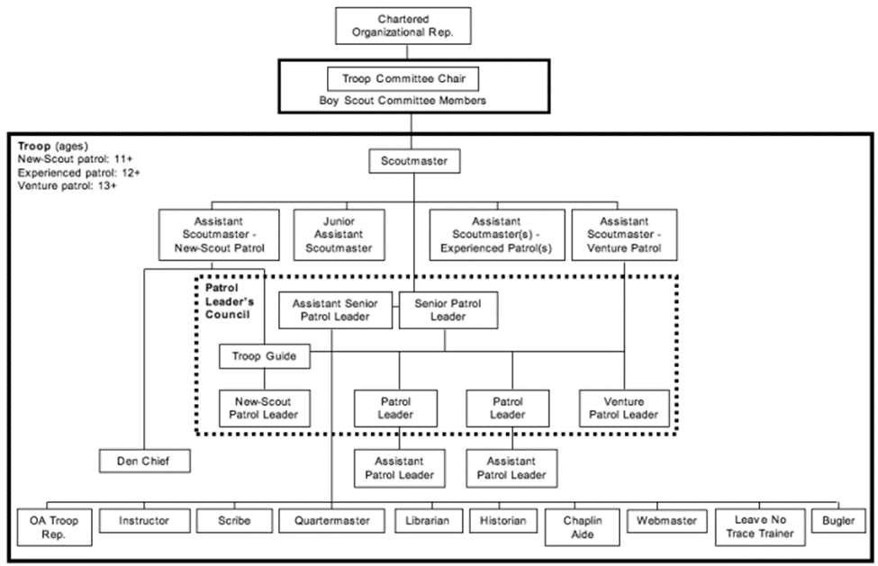
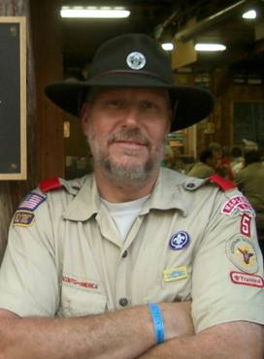
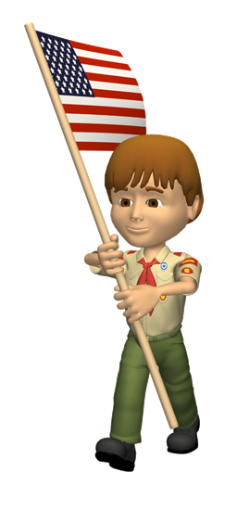
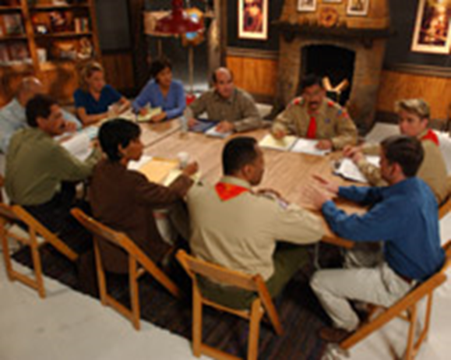

The Troop
The Troop Key 3
Scoutmaster
Unit Commissioner
Committee Chair
Notes:
The Troop Key 3
Explain that the unit Key 3 is a critical component to the success of the troop. The troop Key 3 consists of the troop committee chair, the Scoutmaster, and the chartered organization representative. The unit commissioner serves as an advisor to the Key 3. This group usually meets once a month to discuss the troop, its challenges, upcoming events, and progress toward completing its action plan and Journey to Excellence goals just like any other Scouting Key 3. It is a time for the troop’s Key 3 to spot early warning signs and work together toward continued troop success to support the troop’s youth leaders. The unit commissioner meets with them to support their efforts, to help with problem solving, and to keep the troop moving in sync with the district and council calendars.
Summary
When the relationship between the chartered organization and the troop is strong and the troop is involved in the life of the organization, the troop is nearly always successful in providing quality programs, recruiting and retaining members, and making a difference in the life of the chartered organization and the families involved. The troop committee is instrumental in fostering that relationship.

Slide 4
Troop Committee
The Troop Committee
Supports the Scoutmaster in delivering a quality troop program. Members ensure quality adult leadership is recruited and trained. Selects the Scoutmaster
Handles troop administration; responsible for finances, adequate funding, and disbursements with approved budget.
Obtains, maintains, and properly cares for troop property. It ensures the troop has an outdoor program with a minimum of 10 days and nights of camping per year.
Serve on boards of review and plan and conduct courts of honor; support the Scoutmaster in working with individual boys and handling problems that may affect the troop.
Provides for the special needs and assistance some boys may require and helps with the Friends of Scouting campaign.
Handles charter renewal and advancement and ensures adults are current with Youth Protection training.
Minimum number of committee members is three, one of whom serves as a committee chair; no maximum number.
Troop committee members serve for a year at a time.
Develop annual program plan. Conduct Troop Resource Survey.

Slide 5
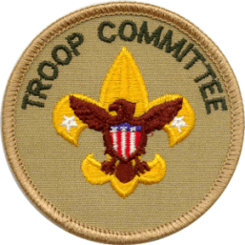

New Unit Coordinator I
Appointment :
  Appointed by and report to the Unit Committee Chair.
  Work with and are supported by the District Membership Chair as well as by unit leadership, the sponsoring organization, and commissioners.
https://scoutingwire.org/marketing-and-membership-hub/councils/new-member-coordinator/
https://41zfam1pstr03my3b22ztkze-wpengine.netdna-ssl.com/wp-content/uploads/2017/05/NMC-Position-Description.pdf

Slide 6
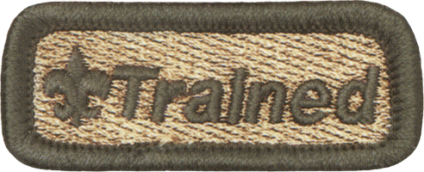
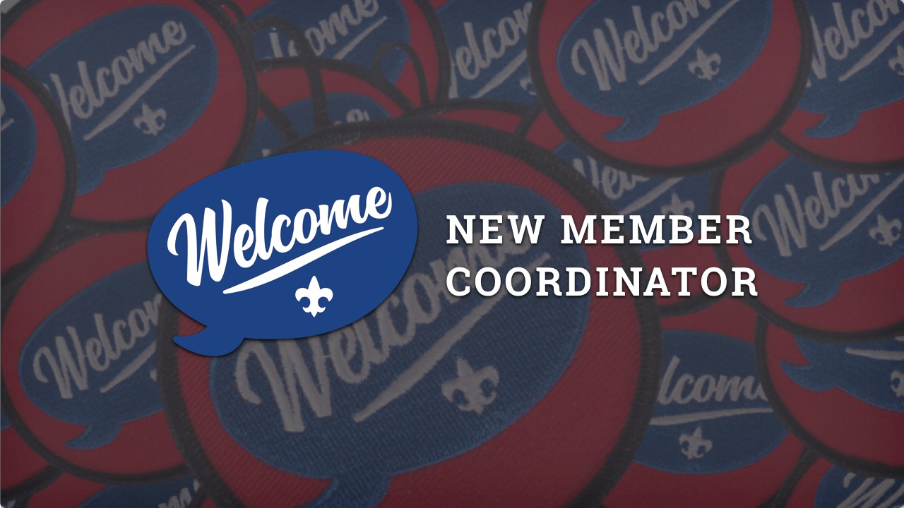
New Unit Coordinator II
Duties:
  General:
    Serve as welcoming ambassadors for the unit.
    Work with the unit committee in developing and implementing the Unit Membership Plan.
    Participate in New Member Coordinator training and collaborate with the district membership team
  Specific:
    Share the benefits of Scouting.
    Coordinate unit recruitment.
    Guide the joining and welcoming process for youth and their families
New Member Coordinator Learning Plan (43 minutes):
This course provides the basic information about the role of the New Member Coordinator and how they help welcome new families into units.

Slide 7
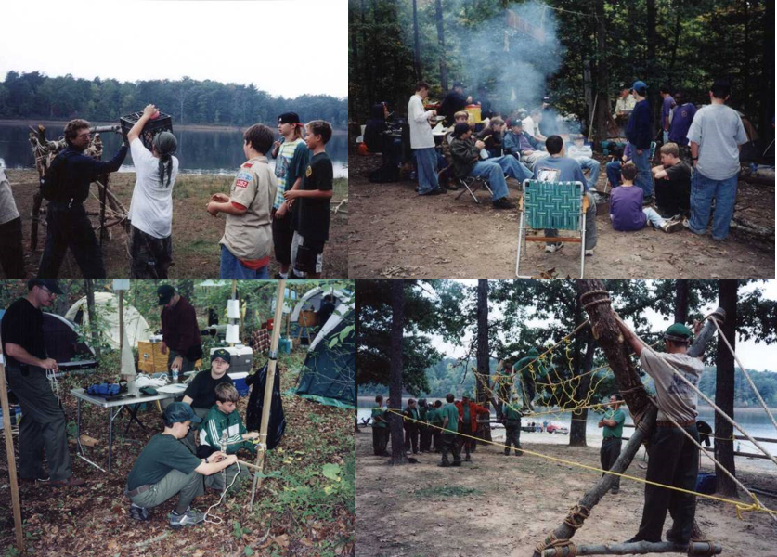
Questions?

