Slide 1

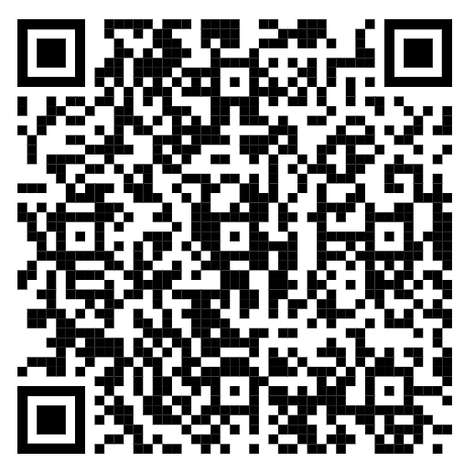
Welcome to the NOVEMBER 2025 ROUNDTABLE!
All attendees please sign in. Be sure to make an entry for one unit’s attendance.
If you are representing a unit, sign in as a leader in that unit, and not a district position.
SIGN IN HERE

Slide 2



Welcome to the Talakto District Roundtable!
Don’t Forget…
Thanksgiving!

Slide 3





6 November 2025
Talakto District Roundtable
7:00 PM
Invocation – SBRS
Presentation of Colors – Kaskanampo Chapter OA
District Commissioner – Jimmy Sneddon
District Chairman – Jeremy Gaertner
District Director –
Training – Tom Billig – Training
New Member Coordinator – Richard Stone - Slide
Recharter – Stephen Forsythe
Popcorn – Kathy Weaver – Pop

Slide 4


6 November 2025
Talakto District
Scouts BSA Roundtable
7:15 PM
Scouts BSA Session Announcements
Recent Activities – SBRS
Stoves - SBRS
Flag Pickup – Maple Hill & Memory – 15 Nov
Christmas Party – Giga Parts – 4 December
Scoutmaster’s Minute – SBRS
Next: Roundtable 8 January 2026

Slide 5


hrsar2@att.net
Chris Whitacre

Slide 6
Welcome to the NOVEMBER 2025 ROUNDTABLE!
All attendees please sign in. Be sure to make an entry for one unit’s attendance.
If you are representing a unit, sign in as a leader in that unit, and not a district position.
SIGN IN HERE

