Slide 1
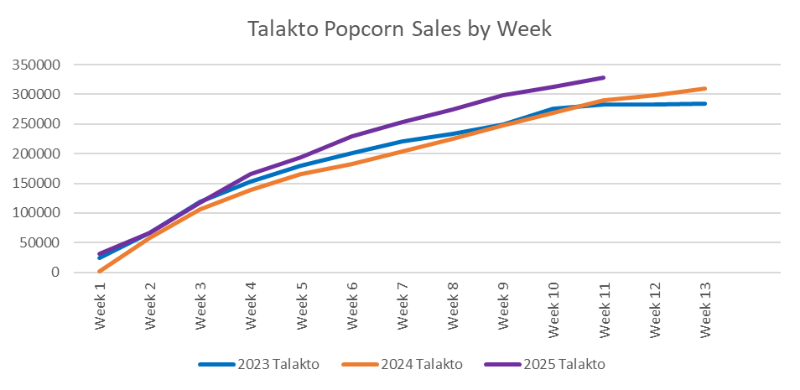
Popcorn – TALAKTO IS AWESOME!!!!!!!
Talakto currently represents 63.7% of the Greater Alabama Council popcorn sales at $330,980.
Approaching an all-time record high for a District in popcorn sales
THRIFTY. Work to pay your own way.

